Slide 1
MOSDEX A New Standard for Data Exchange with Optimization Solvers
Dr. Jeremy A. Bloom
jeremyblmca@gmail.com
July 8, 2020

Slide 2
Synopsis
Rationale for a new data exchange standard
Overview of MOSDEX
MOSDEX Syntax
MOSDEX Example – Transshipment in Instance Form
MOSDEX Example – Transshipment in Query Form
Optimization Architecture and MOSDEX
The Big Data Future
Additional MOSDEXCapabilities
MOSDEX Resources

Slide 3
Rationale
MPS format is the de facto standard for data exchange and model specification for many optimization solvers
It has several advantages:
Sparsity
Text-based
Non-proprietary
However, it also has many deficiencies:
Lack of an output standard
Lack of model-data separation
Difficulty in scaling
Lack of indexing
Column orientation
Extensions beyond linear models

Slide 4
The MOSDEX Standard Mathematical Optimization Solver Data Exchange
Overview
Efficient for machines, readable by humans
Represent the data in relational form
Use the JSON standard
Augment the data representation with mathematical modeling objects
Design Principles
Independence from and support for
multiple optimization solvers and APIs,
multiple algebraic modeling languages, and
multiple programming languages.
Minimize custom coding required of the target solvers and modeling languages
Rely on the public, published APIs of the target solvers and languages
Avoid requiring users to customize the parser and/or code generator or emulator

Slide 5
Why JSON?
A standard format for data exchange http://json.org/
Simple syntax
Primitive: String, Integer, Double, IEEEDouble
Object: { “name” : value, …} unordered key: value pairs
Array: [ value, …] ordered items of mixed types
Nesting: Array can contain Objects, Object can contain Arrays
Support in many languages
Statically typed (e.g. C++, Java) require classes that map to JSON objects and arrays
Dynamically typed (e.g. JavaScript, Python) can create objects on the fly from JSON
JSON Schema http://json-schema.org/
A meta-standard for describing JSON files

Slide 6
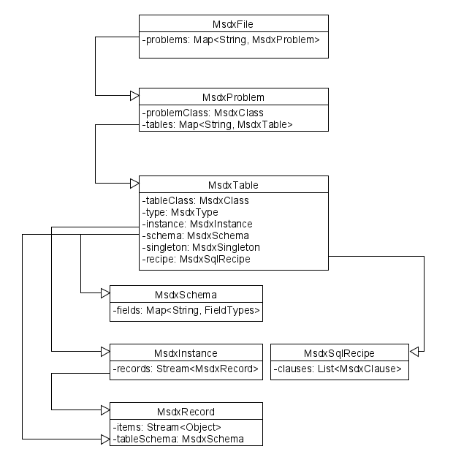
MOSDEX Syntax
FILE contains one or more named PROBLEMS
A FILE is intended to be self-contained but may link to other FILES
PROBLEM contains one or more named TABLES plus auxiliary keyword objects
A PROBLEM may contain a full optimization problem, data only, or a module of a decomposition
TABLE is the fundamental data structure of MOSDEX
Think of a table in a relational database with a fixed number of columns and an indefinite number of records (rows)
A TABLE’s class is DATA or a modeling object – VARIABLE, CONSTRAINT, OBJECTIVE, or TERM
A TABLE’s type depends on its class – e.g. VARIABLE types are CONTINUOUS, INTEGER or BINARY
A modeling object TABLE represents a family of related objects differentiated by a key. A key (i.e. subscript) can have one or more dimensions
A TABLE can have either Instance form or Query form

Slide 7

MOSDEX Syntax (continued)
Instance-form TABLE contains data
Query-form TABLE is specified by an SQL query
Singleton TABLE is a special instance that contains a single record
Every TABLE has a SCHEMA
Specifies the name and datatype of each field (column) in the TABLE
Instance TABLE has explicit SCHEMA
Query TABLE has SCHEMA implied by the query
Singleton TABLE has SCHEMA implied by the data
Data TABLE can have any reasonable schema Modeling object TABLE has a schema dictated by the solver
PROBLEM can contain a mixture of instance, query, and singleton TABLES

Slide 8
Why SQL?
There is a deep and intimate relationship between the syntax of optimization models and the structure of relational data
SQL permits compact specification of complex data transformations and optimization structures
SQL is widely known and used by developers
Relatively easy to learn
Many platforms support it
ANSI standard (with product-specific variances)
Portable
Efficient data manipulations through query optimization
Bloom, Optimization Modeling and Relational Data. https://github.com/JeremyBloom/Optimization---Sample-Notebooks/blob/master/Optimization%2BModeling%2Band%2BRelational%2BData%2Bpub.ipynb

Slide 9
Modeling Objects – Why do we need them?
MOSDEX is a data standard, not a modeling language
MOSDEX lacks syntactic features (e.g. a sum operator, set operators) that make modeling languages friendly for users, although many of these are available through SQL
MOSDEX needs compatibility with MPS
MPS format combines data exchange with definitions of the modeling objects - rows (constraints and objectives) and columns (variables and coefficients)
However, MPS was defined before solvers had modeling APIs and before optimization domain-specific languages had been invented
Today, when many solvers have modeling APIs and with a number of optimization domain-specific languages, modeling objects are less important
Modeling objects are still needed for solvers without modeling APIs (e.g. Clp)
Standardized modeling objects are potentially useful for model export (serialization) and import (deserialization)
However, even without modeling objects, a standard for data exchange can still realize most of the value

Slide 10
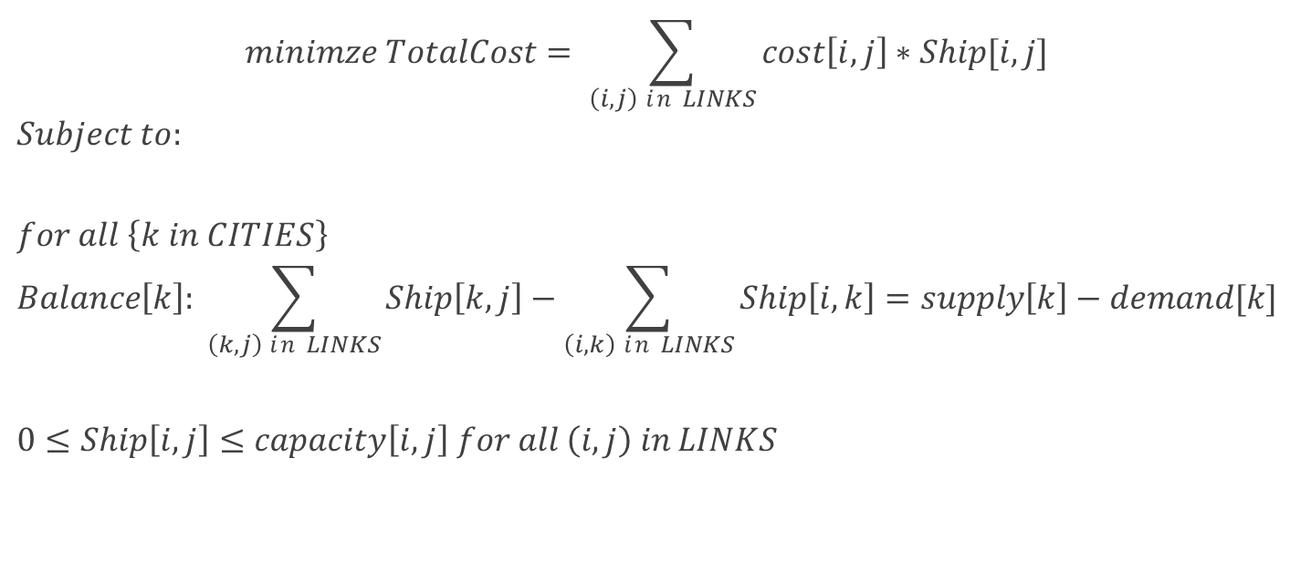
MOSDEX Examples Transshipment Network
$$minimze TotalCost= \sum_{\left(i,j\right) in LINKS}{cost\left[i,j\right]∗Ship[i,j]}$$
$$Subject to:$$
$$for all \left\{k in CITIES\right\}$$
$$Balance\left[k\right]: \sum_{\left(k,j\right) in LINKS}{Ship\left[k,j\right]−\sum_{\left(i,k\right) in LINKS}{Ship\left[i,k\right]=supply\left[k\right]−demand[k]}}$$
$$0≤Ship\left[i,j\right]≤capacity\left[i,j\right] for all \left(i,j\right) in LINKS$$
from https://ampl.com/BOOK/EXAMPLES/EXAMPLES2/net1.mod

Slide 11
MOSDEX Examples Transshipment Network in Instance Form
Show demo

Slide 12
MOSDEX Examples Transshipment Network in Query Form
Show demo

Slide 13
Business Solution Architecture
Enterprise Data Service
Extract, Validate, Transform, Load
Application
Consumer Services
Visualize,
Interact
Application Data Model
The purpose of the modeling layer is to move data efficiently and quickly between external sources and the internal data structures of the solver
Modeling Layer
Tableau Data Model
Solver Service

Slide 14
Dataflow for an Optimization Application
Extract and Validate Data
Transform
Create Solver Objects
Frequently, computational effort involved in these steps is unrecognized
Solve
Extract and Transform Solution

Slide 15
How MOSDEX Supports the Dataflow
MOSDEX standardizes the dataflow
Query-form tables document extraction, validation, and transformation of data in a platform independent manner
MOSDEX parser translates JSON into the MOSDEX Object Model in the underlying programming language, e.g. C++, Java, Python, etc.
MODEX Object Model transforms into classes of the solver’s API, standardizing the solver interface
The solver’s API classes transform back into the MOSDEX Object Model which then provides access to the solution by the consuming applications; MOSDEX documents the execution of these transformations

Slide 16
The Future: Big Data and Streams
Analytics in general is moving strongly and rapidly to applications on big data sets
Optimization applications already support large data sets (O(1M) variables and O(100K) constraints and solvers on the horizon could increase instance sizes by another order of magnitude or more
Examples: control of millions of energy storage batteries in hybrid vehicles, stochastic electricity unit commitment, individualized marketing offers to millions of customers
Data handling tools such as Hadoop and Apache Spark can now process enormous data sets, using distributed, parallel processing
Data exchange format for optimization needs to be able to adapt to big data as well

Slide 17
Big Data Operations
Parallel Processing: Multi-processor architectures are becoming more common that permit operating on data sets in parallel
Streaming: Data flows from a source (e.g. file, Twitter feed, etc.) to a destination (e.g. an optimization solver) without an intermediate resting place
Creating intermediate objects can overwhelm the stack space of the processor
Streams can support parallel processing on multiple processors
Operators work directly on a stream rather than on the individual items in the stream (unlike an iterator)
Many languages now support some form of stream processing
Transformation: transform each row of a data set to a new row in another data set (e.g. a Map operation)
Terminal Action: produce a result, e.g. a scalar, that is not a data set (e.g. a Reduce action)
Big data handlers (e.g. Hadoop, Spark) are optimized to perform these operations efficiently.
Transformations are evaluated in lazy fashion; that is they are performed only when a action is initialed and they may be reformulated for efficient execution
Thus, to the extent possible, data handling operations should be performed inside a big data handler

Slide 18
Additional MOSDEX Capabilities
Linear, Mixed Integer, and Quadratic Optimization Models
Modular Structures - Decomposition, Stochastic Programming, etc. (experimental)
Nonlinear Optimization Models (experimental)
MOSDEX is designed for extension

Slide 19
Next Steps for MOSDEX
Agree on the basic structure of MOSDEX.
 Draft rigorous syntax specifications for the new standard.
 Write examples of the new standard using widely understood optimization problems (of which there are many published examples) with a view towards testing and extending the new standard where necessary. Examples should include (but not be limited to) network models, time-staged models involving lagged variables (e.g. production/inventory problems), and stochastic programs.
Code samples demonstrating how the new standard utilizes different solvers’ APIs and different modeling languages.
Code parsers for the new standard for reading and writing files in the various target languages. In this step, adapt existing JSON parsers in the target languages to accept the syntax of the new standard.
 Publish the documentation and code developed in the previous steps on the COIN-OR Github site and solicit comments from users.

Slide 20
Summary
MOSDEX is intended as a data and model exchange format that supports multiple solver APIs in multiple programming languages and multiple modeling languages
The MOSDEX includes the following aspects
It represents the data in relational form
It uses the JSON standard
It augments the data representation with mathematical modeling objects
There is a defined development path for MOSDEX

Slide 21
MOSDEX Resources https://github.com/coin-modeling-dev/MOSDEX-Examples/tree/master/MOSDEX-1.2
MOSDEX Standard
MOSDEX Syntax v1-2.docx
MOSDEX Schema
MOSDEXSchemaV1-2.json

Slide 22
MOSDEX Examples https://github.com/coin-modeling-dev/MOSDEX-Examples/tree/master/MOSDEX-1.2
Volsay_1-2.json – a simple 2-variable, 3-constraint linear program illustrating instance form tables
net1a_1-2.json – a network flow linear program illustrating query form tables
net1b_1-2.json – the same network flow linear program using instance form tables
sailco_1-2.json – a production planning linear program illustrating lagged inventory decision variables
warehousing_1-2.json – a facility location mixed-integer linear program illustrating a large-scale, structured problem in query form
multicommodity_1-2.json – a multi-commodity network flow linear program in extensive form
cuttingStock_1-2.json – a cutting-stock mixed-integer linear program illustrating use of modular structure for decomposition in a column generation algorithm
trafficNetworkQP_1-2.json – a quadratic programming problem
trafficNetworkNLP_1-2.json – the same problem formulated as a nonlinear program with expression graph

